Slide 1

Employee Data Analysis using Excel
Student name: J. Fakiha sultana
Register number: 122202282
Department: B. Com (corporate secretaryship)
College name: Valliammal college for women
1
Notes:
1

Slide 2

PROJECT TITLE
Employee Performance Analysis based on Gender, Departments and FTE using Excel
2

Slide 3



AGENDA
Problem Statement
Project Overview
End Users
Our Solution and Proposition
Dataset Description
Modelling Approach
Results and Discussion
Conclusion
3/21/2024 Annual Review
3

Slide 4

PROBLEM STATEMENT
The problem is to analyze employee performance across gender, departments and FTE status using Excel. The analysis will focus on comparing performance metrics across these categories to uncover actionable insights that can enhance overall workforce management and productivity.
4

Slide 5

PROJECT OVERVIEW
The analysis will involve creating pivot tables, charts and summary statistics to compare performance metrics across different groups.
.
5

Slide 6

WHO ARE THE END USERS?
The end users of this employee performance analysis are HR managers, department heads, senior executives and organizational leadership. They will use the insights to make informed decisions in employee development, resource allocation and overall workforce strategy.
6

Slide 7

OUR SOLUTION AND ITS VALUE PROPOSITION
Our solution offers a robust employment performance analysis by leveraging excel to evaluate data across gender, departments and FTE metrics. This enables organizations to gain critical insights into workforce performance and identify disparities.
7

Slide 8
Dataset Description
The dataset for employment performance analysis includes key variables such as gender, department and FTE to enable comprehensive evaluation of workforce performance ratings, KPIs and tenure allowing for in-depth analysis of trends across gender and departmental lines.

Slide 9

THE "WOW" IN OUR SOLUTION
The ‘wow’ factor of your employment performance analysis solution is its ability to deliver deep, actionable insights through the familiar and cost-effective platform of excel.
3/21/2024 Annual Review
9

Slide 10
MODELLING
The model employment performance analysis start by organising your data into a structured spreadsheet with columns for key variable such as gender, departments and FTE.
10

Slide 11
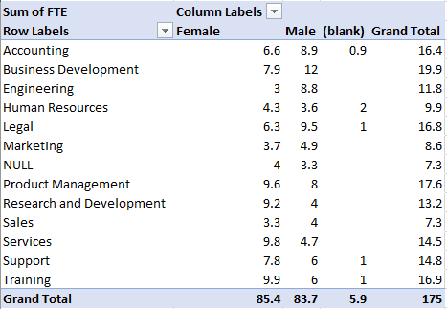
RESULTS
1. TABLE
11

Slide 12
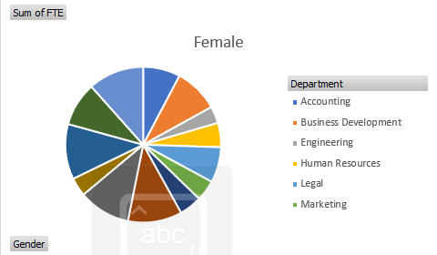
2. PIE CHART

Slide 13
Conclusion
In conclusion, conducting employment performance analysis provides a actionable approach to understanding workforce dynamics. By leveraging excel’s analytical and visualization tools, organisations can uncover critical insights into performance disparities, departmental efficiency and the impact of workload on productivity.

